Slide 1
Isle of Adventure!
Game Development Team - Sean Blissett, Tyler Johnson, Mike Roark
- A skilled and dedicated game development team!

Slide 2
Isle of Adventure Introduction
Story Arc
Game Play
Platform
Milestones
Resource Estimates
Summary

Slide 3
Isle of Adventure Story Arc
Saving the World
Empowerment through weapons
Defend the local town
Clear the forest of enemies
Ultimately destroy the evil overlord

Slide 4
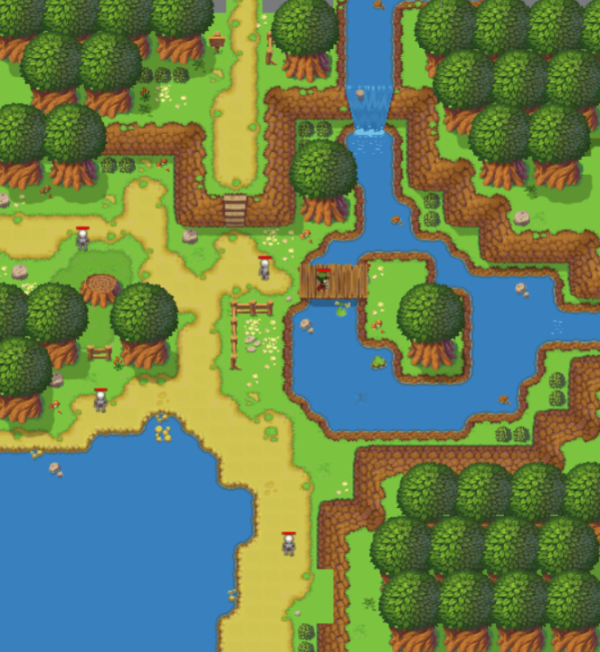
Isle of Adventure The World!!!
Prototype

Slide 5
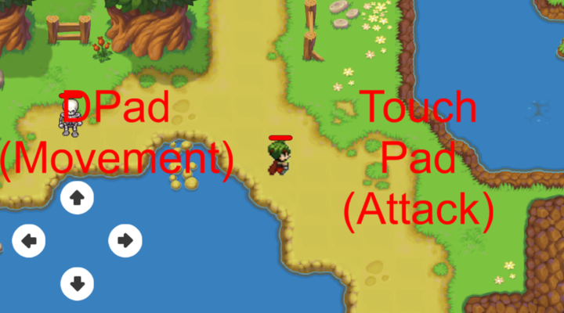
Isle of Adventure Game Play
Mobile input controls – Directional Pad with Button
Top Down Adventure Game
Real-time Action battles
Challenging mini-games to strengthen your character
Prototype

Slide 6
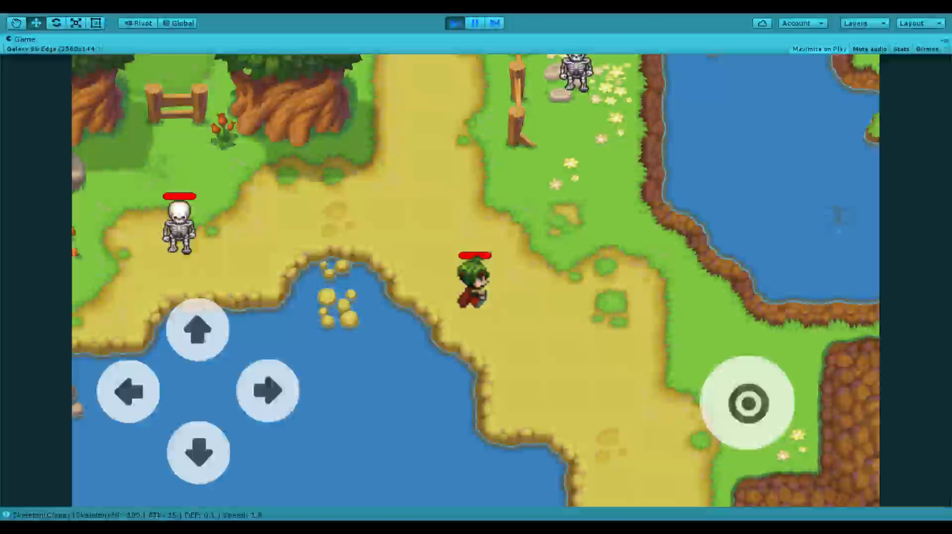
Isle of Adventure Gameplay Video
Prototype

Slide 7
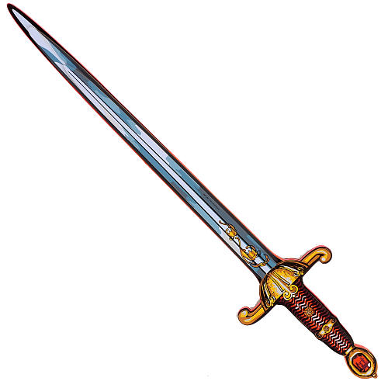
Isle of Adventure “Those who live by the sword – Die by the sword”
Upgrade Attack
Upgrade Defense
Upgrade Health

Slide 8

Isle of Adventure Platform
Android and iOS mobile device
Built with Unity 3D scripting in C#
Device Filter - FAT ARMv7+ x86

Slide 9
Isle of Adventure Milestones
Week 1 – Prototyping all game mechanics.
Week 2 – Alpha version
Week 3 – Beta version
Week 4 – Final test and release

Slide 10
Isle of Adventure Development Estimate
World – 60 resource hours
UI – 15 resource hours
Battle system/Enemy AI – 120 resource hours
Weapon Upgrade System – 24 resource hours
Forest Mini-game - 27 resource hours
Town Mini-game - 27 resource hours
Castle Mini-game/End-game – 72 resource hours
Defect resolution – 60 resource hours
Software QA testing - 75 resource hours
Total estimated resource hours = 480

Slide 11
Isle of Adventure Delegated Tasks
Entire Team
World
Testing/Defect Resolution
Sean
Battle systems
Weapon Upgrade System
Tyler
Forest Mini-game
UI
Mike
Town Mini-game
Castle Mini-game/End-game

Slide 12
Isle of Adventure Summary
Thank you for your consideration.
Join us as this Adventure comes to life!
You too could harness the power of the sword!

